Slide 1
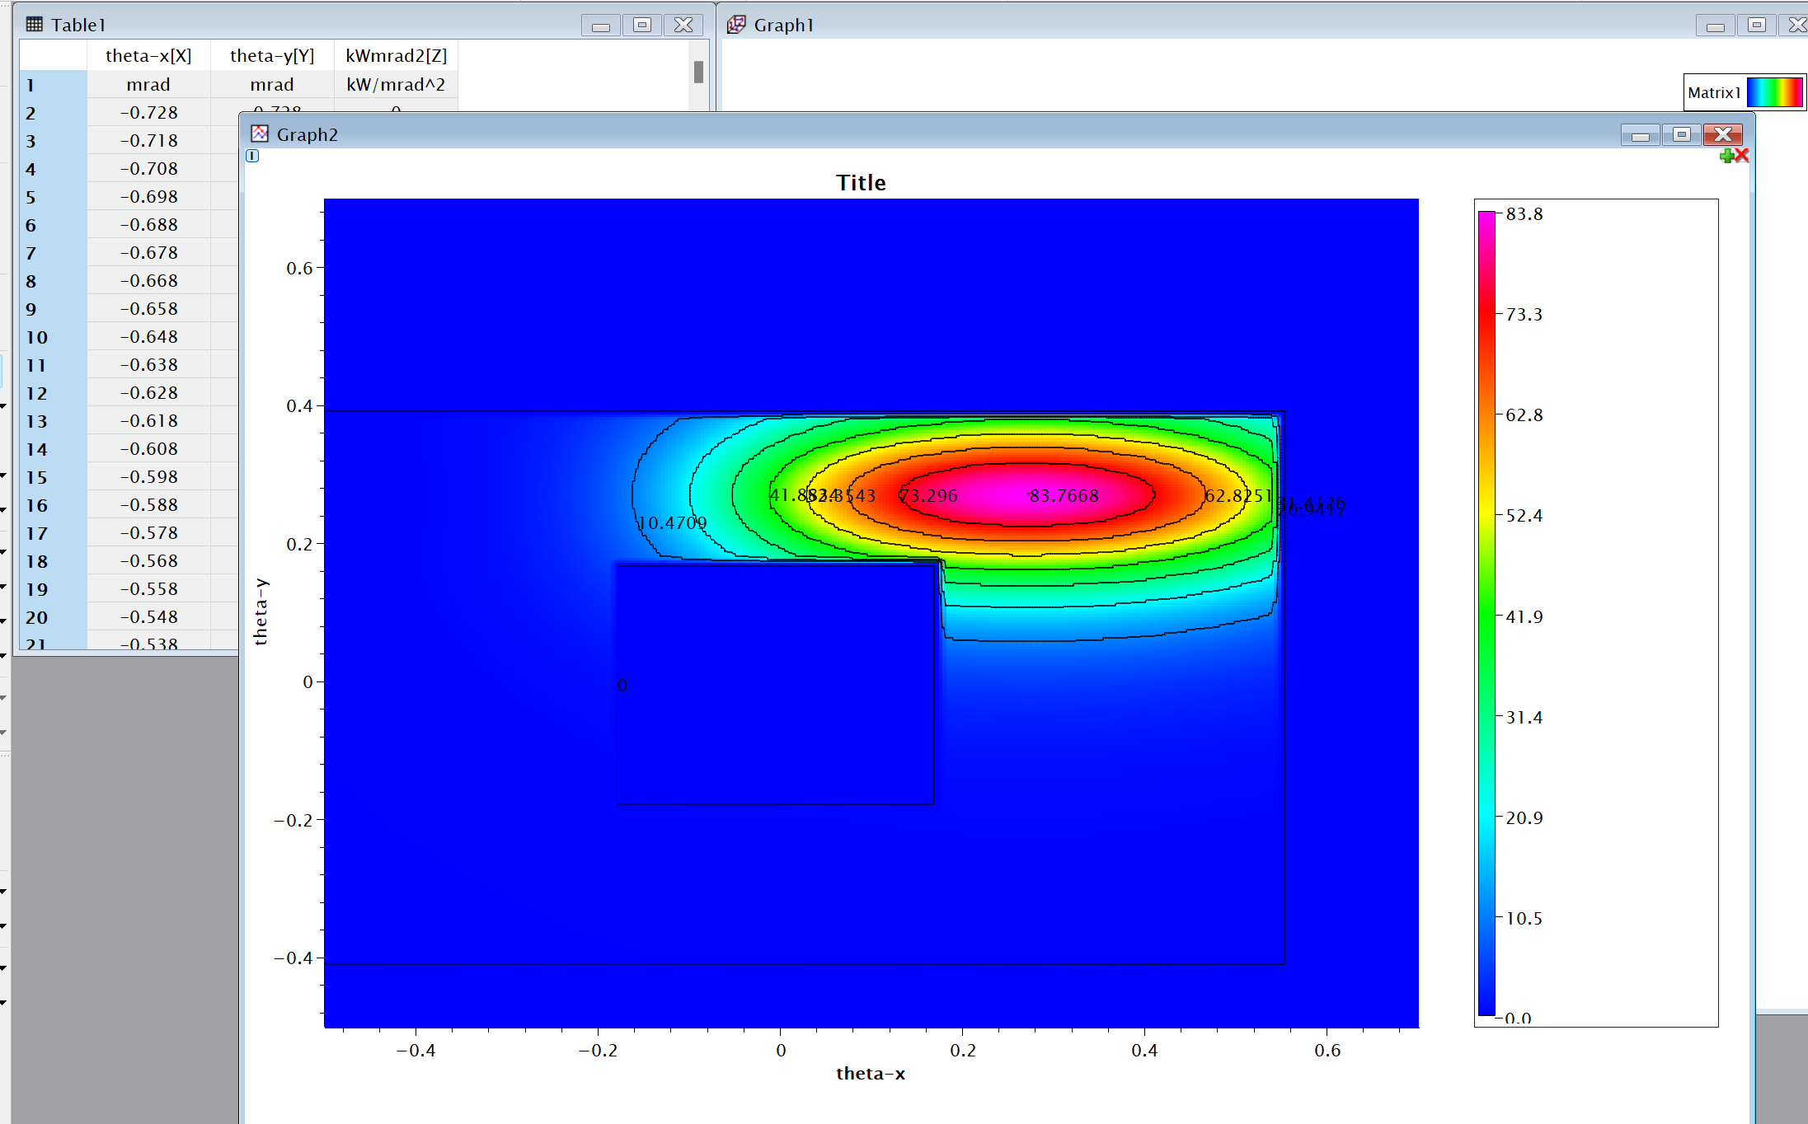

Slide 2
Backup Date: 2024-12-19 15:07:38
-----------------------------------------
----------------ANSYS----------------
ansysFileName=J:\New TPS\front end CAD models\CU18-15A\fixed mask1\CU18-15A fixed mask1 missteering.dat
ansysTotalNode=935,917
ansysTotalElement=654,365
totalFluxElement=4,123
----------------Spectra----------------
spectraFileName=J:\New TPS\front end CAD models\CU18-15A\fixed mask1\CU18-15A fixed mask1-0.data
spectraPeakPowerDensity1=83.58 kW/mrad2
spectraTotalPower1=12.53 kW
spectraMinX=-1.000 mrad
spectraMaxX=1.000 mrad
spectraMinY=-1.000 mrad
spectraMaxY=1.000 mrad
spectraTotalColumn1=201
spectraTotalRow1=201
----------------Geometry----------------
xSource=-3.76
ySource=3.76
zSource=-13800
xTarget=-3.76
yTarget=3.76
zTarget=0.
xSide=-6
ySide=3.76
zSide=-13800
outputFilePath=J:\New TPS\front end CAD models\CU18-15A\fixed mask1
outputFileName=CU18-15A fixed mask1 missteering.inp
totalPowerRatio=1.0

Slide 3
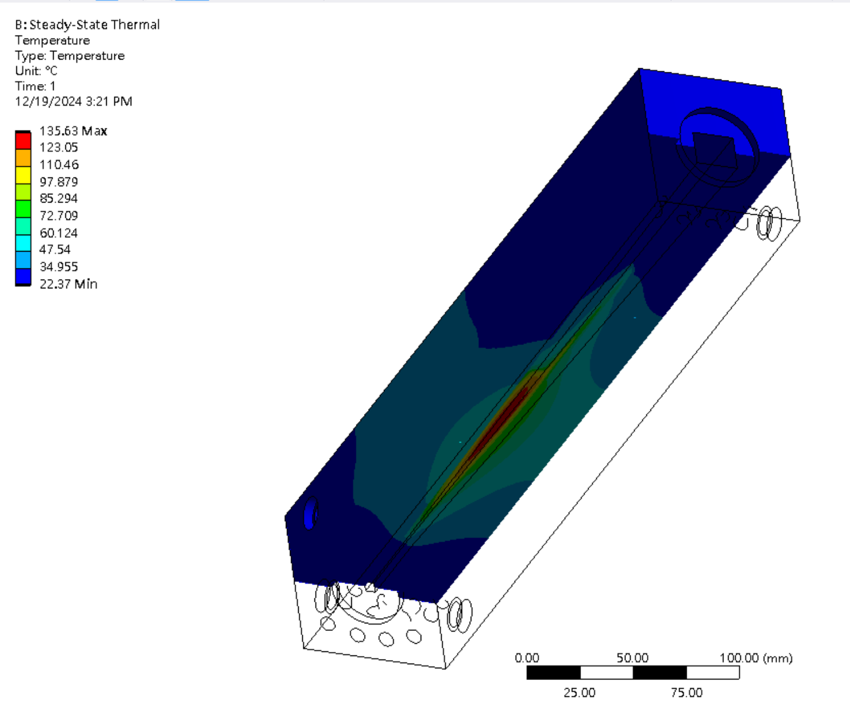
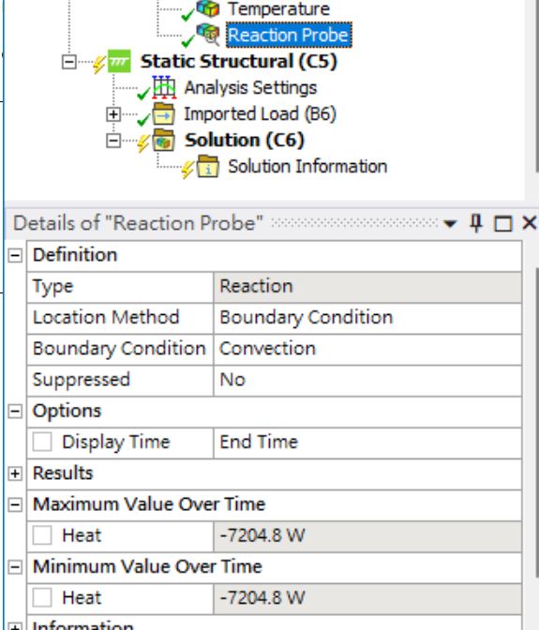

Slide 4
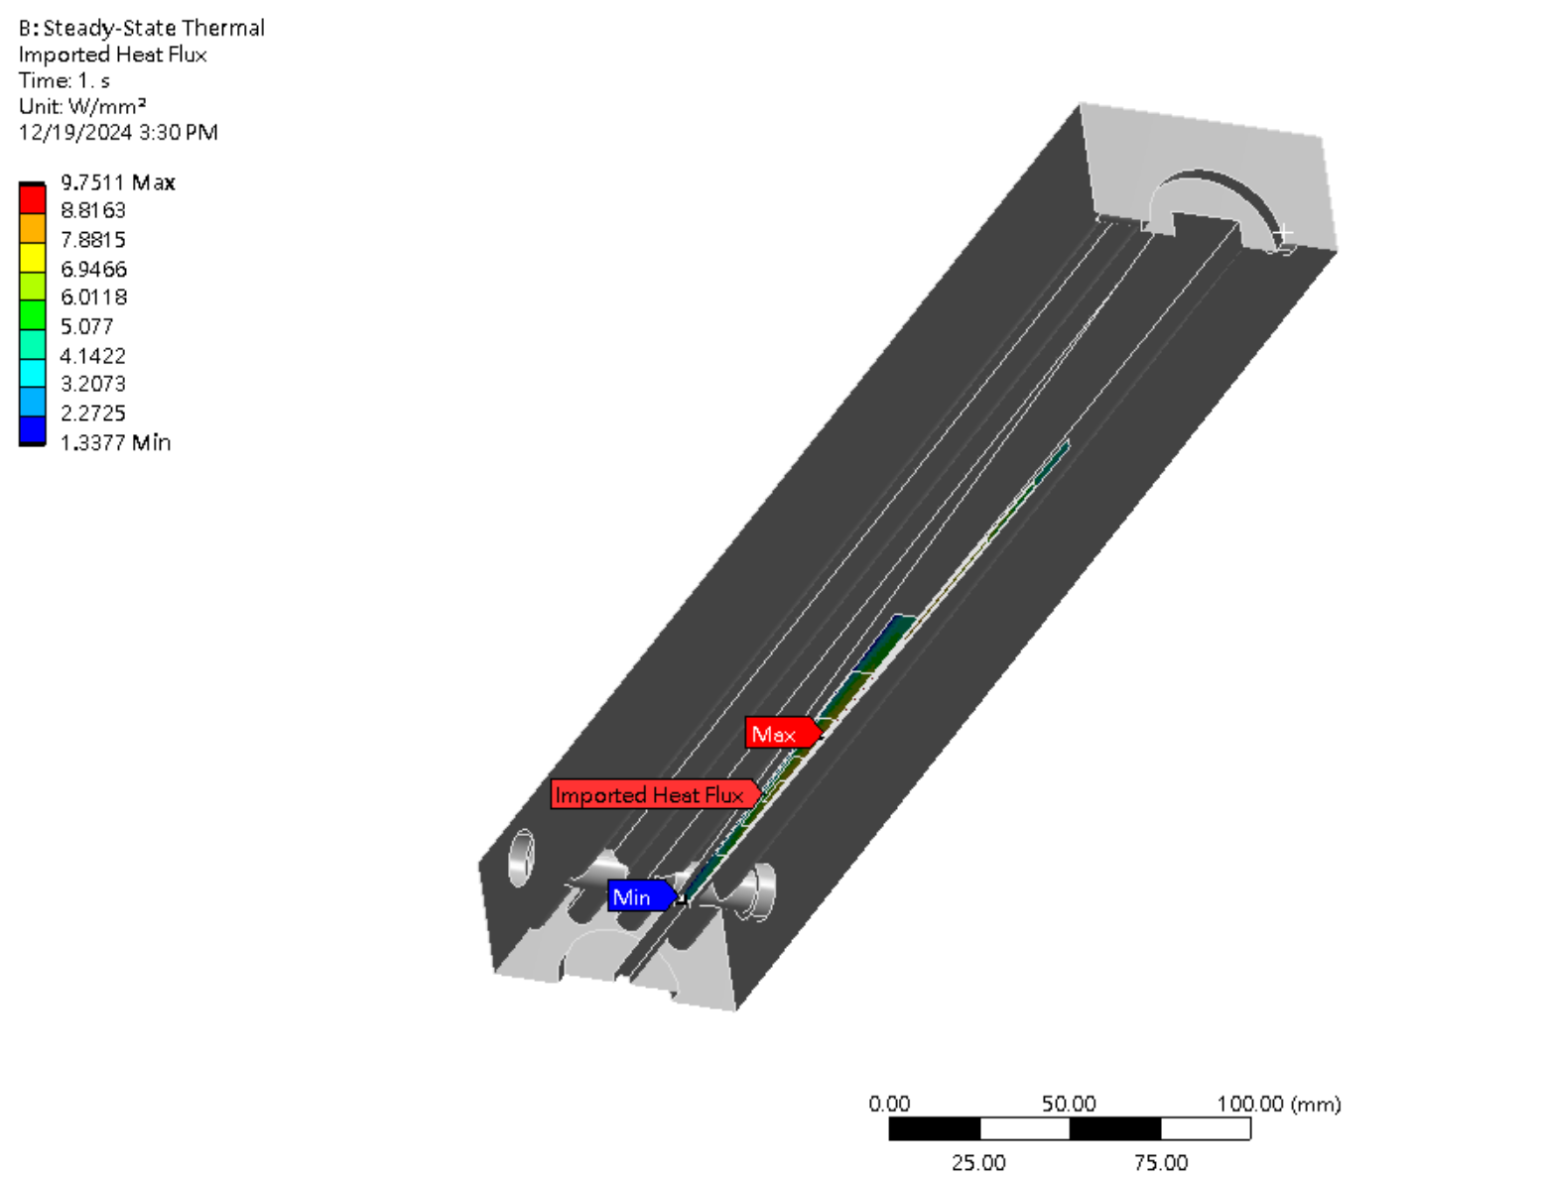

Slide 5
